Slide 1


Presentation On
Submitted By
SIDDHARTH
ARPIT SHARAM
DEEPAK

Slide 2
Index
Abstract
Introduction
Software Requirements Specifications
System Design
Implementation
Testing
Screen Shots
Conclusion
Future Enhancements
References
1

Slide 3
ABSTRACT
For many years Bug Tracking mechanism is employed only in some of the large software development houses. Most of the others never bothered with bug tracking at all and instead simply relied on shared lists and email to monitor the status of defects
Bug Tracking System is a web-based application that is designed to help quality assurance and programmers keep track of reported software bugs in their work. Bugs will be assigned to a person with a bug id, flag, description, project name.
Nowadays, when project are so extensive defects or bugs have been existed as a problem in the system and they are normally inevitable in software development. A bug could be in either a program’s source code or its design.
2

Slide 4
Introduction
Bug Tracking System is a web-based application that is designed to help quality assurance and programmers keep track of reported software bugs in their work..
Bugs will be assigned to a person with a bug id, flag, description,
project name.
Bug can be submitted to the tester with an attachment for the bug
detailed report.
Admin can maintain users, projects, organizations, bug categories, bug priorities, status of bug etc.
3

Slide 5
Purpose Of The Project
Bug Tracking System is to test the application for the bugs and report it to the project manager and developer.
The main intention behind the Bug Tracking System is that to track bugs and report them.
Store the bug information with a unique id in the database.
4

Slide 6
Software Requirement Specification
MINIMUM HARDWARE REQUIREMENTS
Processor | 133-Intel Pentium class processor
Hard Disk | 5GB Recommended
Memory | 1GB of Ram,2GB Recommended
Display | Standard Output Display
Keyboard | Standard Qwerty Keyboard For Interface
Mouse | Standard Mouse With Two Buttons
MINIMUM SOFTWARE REQUIREMENTS
Operating System | Windows-XP and Above
User Interface | HTML, CSS
Client-side Scripting | PHP
Back End | MySQL
Web Server | Apache Tomcat 7.0.22
IDE | Visual Studio Code

Slide 7
Functional Requirements
MAIN MODULE
Admin: This module has the entire access to all other modules, admin creates the project and assigning the projects to the created manager, adding members to the managers, assigning bugs based on the priority.
Manager: Manager has the full access to the particular project assigned by the admin and controls the team member’s access to the bugs assigned.

Slide 8
Developer: Can access the task or bug assigned by the manager, view assigned projects and resolving the assigned bug. Developer can view the bugs list assigned by the manager.
Tester: Tester can access to the projects or bugs assigned by the manager, can view the assigned projects and can add a new bug to the list and send the bug back to the manager. Tester can login to the system and access the assigned projects list.
Reports: Both Admin and Manager can access this module and generate the reports based on the requirements.

Slide 9
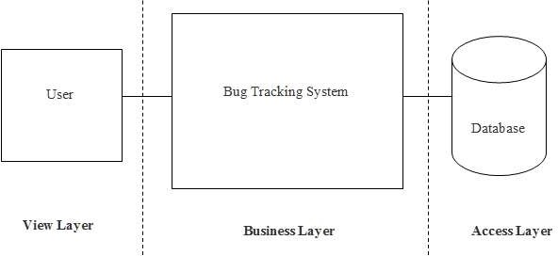
System Design Document
SOFTWARE PRODUCT ARCHITECTURE
ARCHITECTURAL DESIGN
Architectural Design is a process of decomposing a large complex system into small subsystems. These subsystems are meant for providing some related services.
Figure 3.2.1: Architectural design for Bug Tracking System

Slide 10
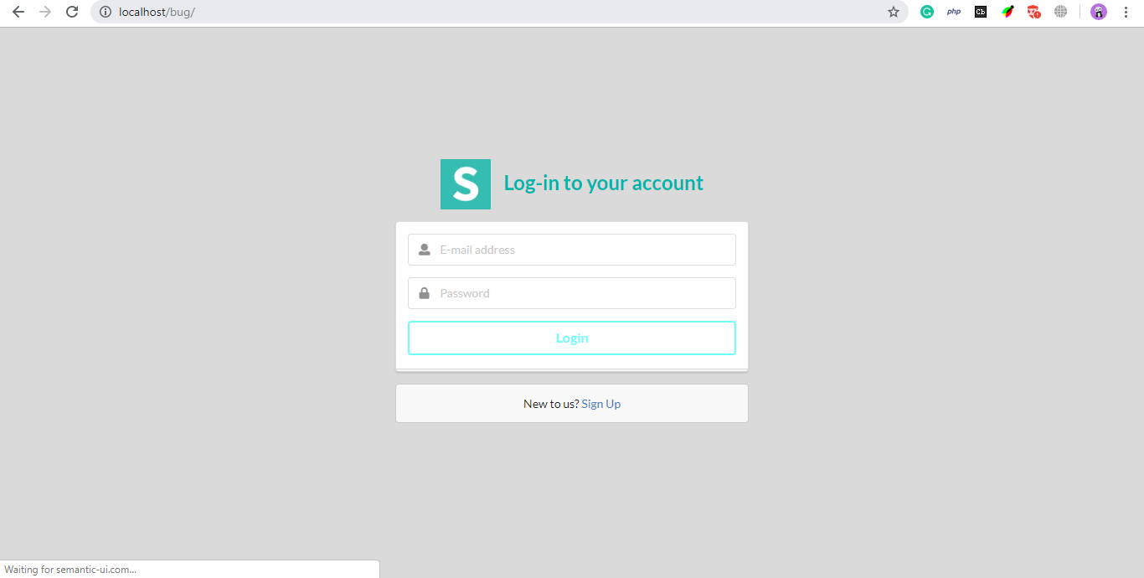
Component Architecture
USER INTERFACE
Login Screen

Slide 11
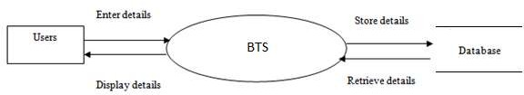
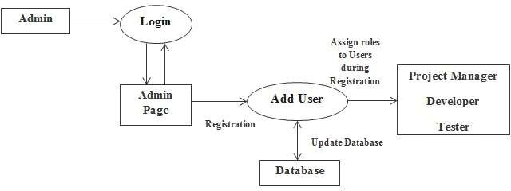
Level 0 DFD or Context Flow Diagram:
Figure 3.4.1: Level 0 Data Flow Diagram for BTS
Level 1 DFD
Figure 3.4.2: Level 1 Data Flow Diagram for BTS

Slide 12
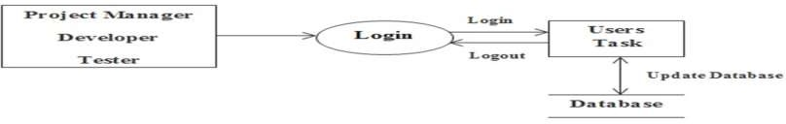
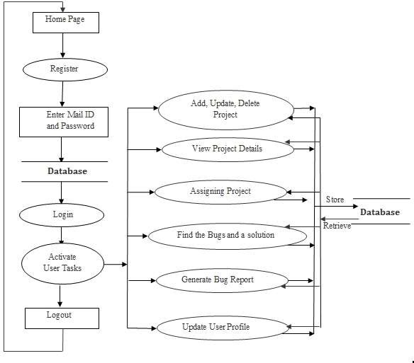
Level 1.1 DFD
Level 2 DFD
Figure 5.7: Level 2 Data Flow Diagram for BTS
11

Slide 13
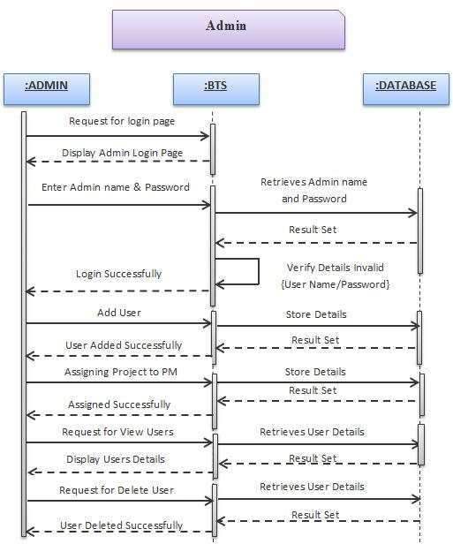
SEQUENCE DIAGRAM
Figure 3.5.2: Sequence Diagram for Administrator
12

Slide 14
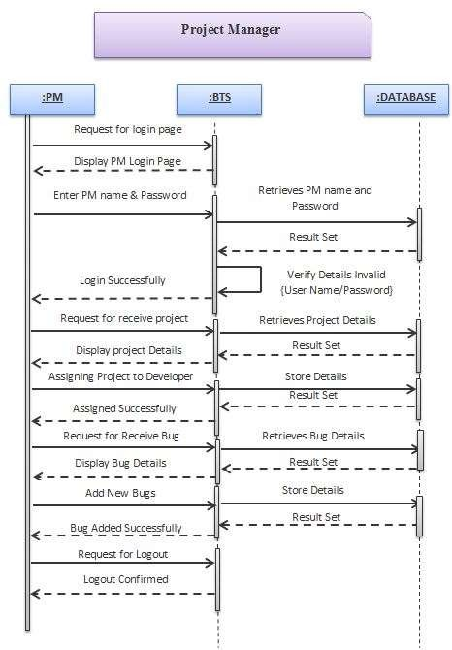
Figure 3.5.2: Sequence Diagram for Project Manager

Slide 15
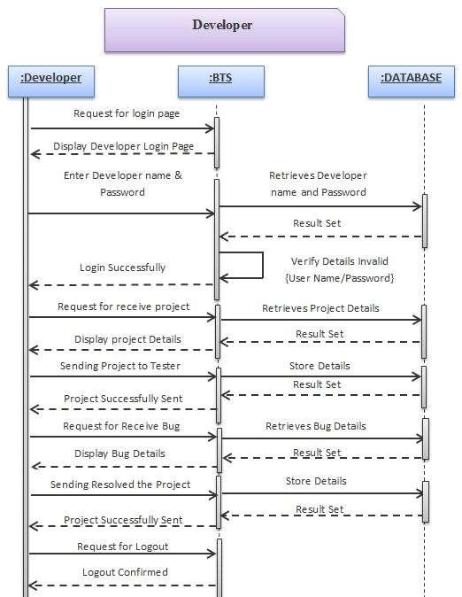
Figure 3.5.2: Sequence Diagram for Developer

Slide 16
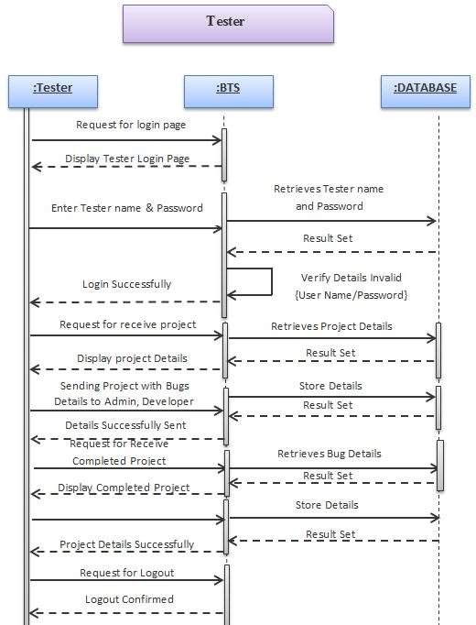
Figure 3.5.3: Sequence Diagram for Tester
15

Slide 17
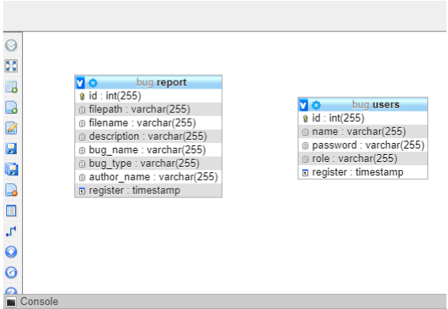
DATABASE DESIGN
16

Slide 18
IMPLEMENTATION
PSEUDO CODES FOR LOGIN IMPLEMENTATION
PSEUDO CODE FOR ADMIN, PROJECT MANAGER, DEVELOPER AND
TESTRER LOGIN
Begin
Input: Username, Password, User type
Connect to Server /*Validations*/ Check for the authorization of user
Enter name and password
/*Enter valid username and password*/
Search in the database (login)
If match found
Connect user profile Module
Else
Display “User authentication failed”
EndIf End
17

Slide 19
TESTING
Table 7.7 Integration Test Cases
Purpose/ Objective: To perform integrated testing of Bug Tracking System.
Assumptions: All types of Users should exist in the system.
Sl. No | Test Cases | Expected Result | Observed Result | Status
1 | Click on the "Login Button" with Admin login credentials | Admin Menu page will be opened | Admin Menu page is opened | PASS
2 | Click on the "Login Button" with All user login credentials | User Profile Page form will be opened | User Profile Page form is opened | PASS
3 | Click on "Add Member" Button | Add Member module should be opened | Add Member module is opened | PASS
4 | Click on "Add Project" Button | Add Project module should be opened | Add Project module is opened | PASS
5 | Click on "View Member" Menu | All Members Details module should be opened | All Members Details module is opened | PASS
6 | Click on "View Bug Details" Menu | View Bug Details module should be opened | View Bug Details module is opened | PASS
7 | Click on "View Report" Button | Bug Reports module should be opened | Bug Reports module is opened | PASS
18

Slide 20
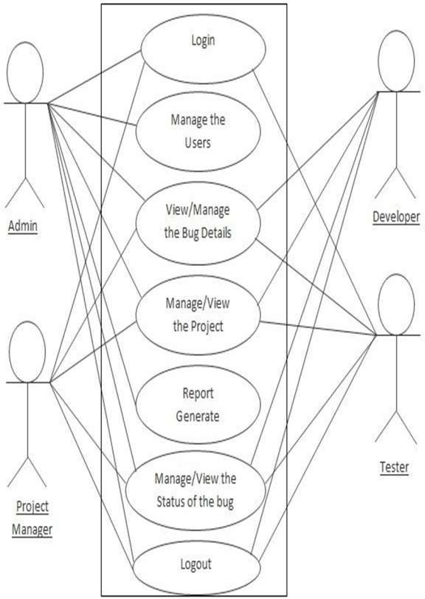
USE CASE DIAGRAM
Figure 3.6.1: Use case diagram for Admin
19

Slide 21
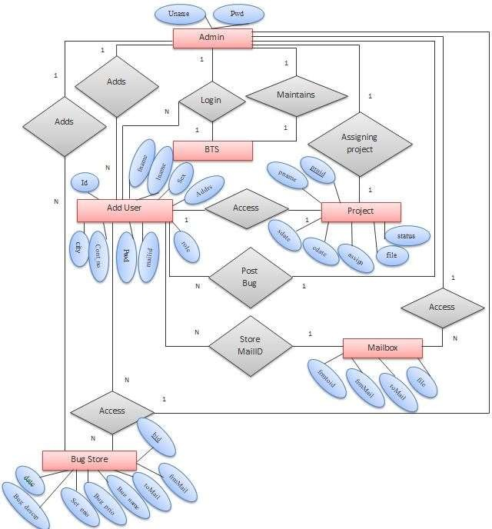
ER DIAGRAM
Figure 3.7: ER diagram for BTS
20

Slide 22
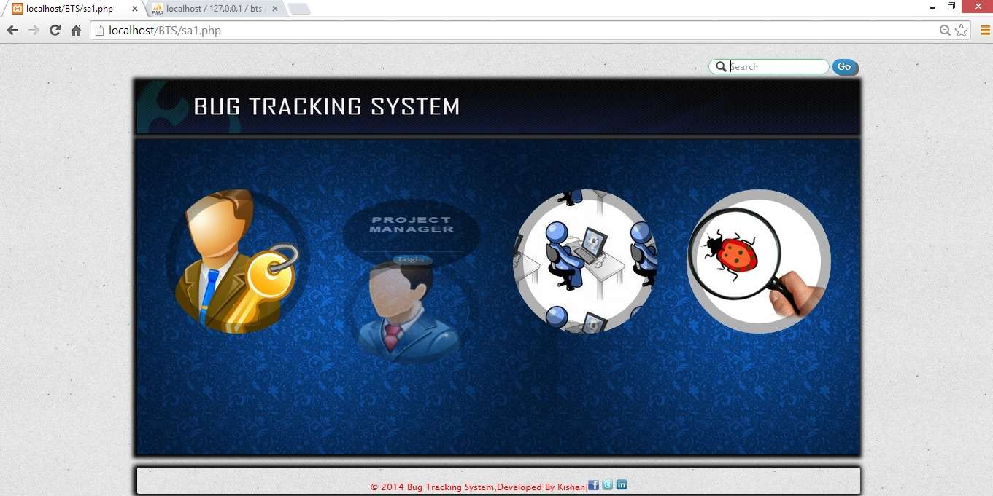
SCREEN SHOTS
Screenshot 1: Home Page
This is the first screen to be displayed when the application is launched.
The user should click his/her login credentials and it enters to the login
page. This should then be verified by the application.
21

Slide 23
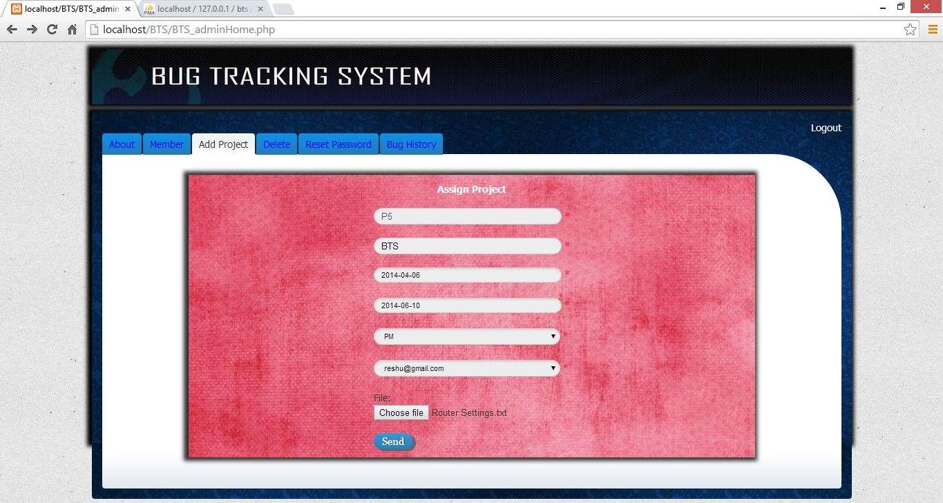
Screenshot 2: Admin Page
In this page admin can assigning the project to the project manager , admin can also view the user details, delete the users, reset the password and also view the
bug history.
22

Slide 24
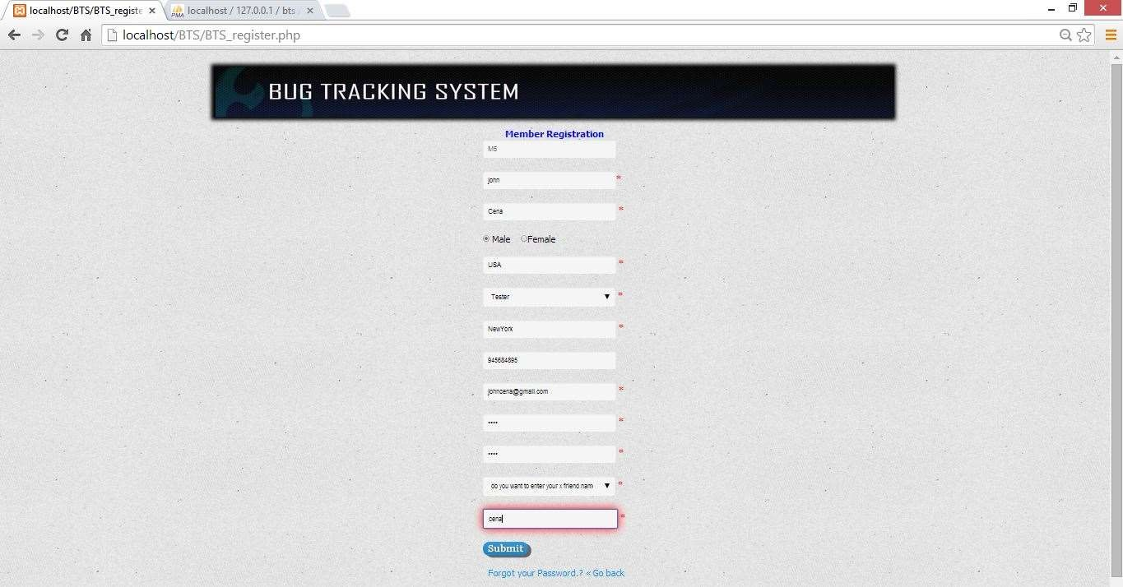
Screenshot 4: Member Registration Page
This page is used to register the member and also assigning a role to the member.
23

Slide 25
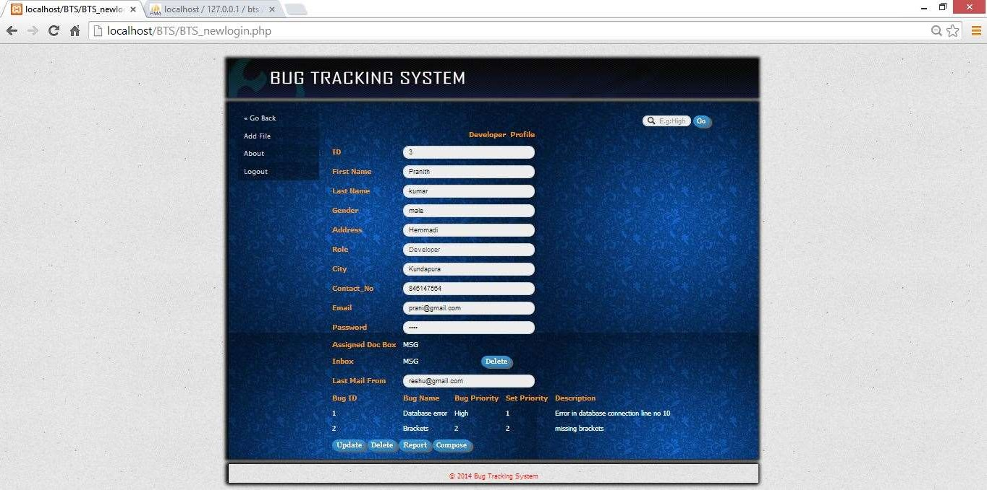
Screenshot 6: Profile Page (Project Manager, Developer and Tester)
This is the profile page of the users, its shows the user’s details and received bug details, then here he/she can update his/her details and also delete his/her
profile.
24

Slide 26
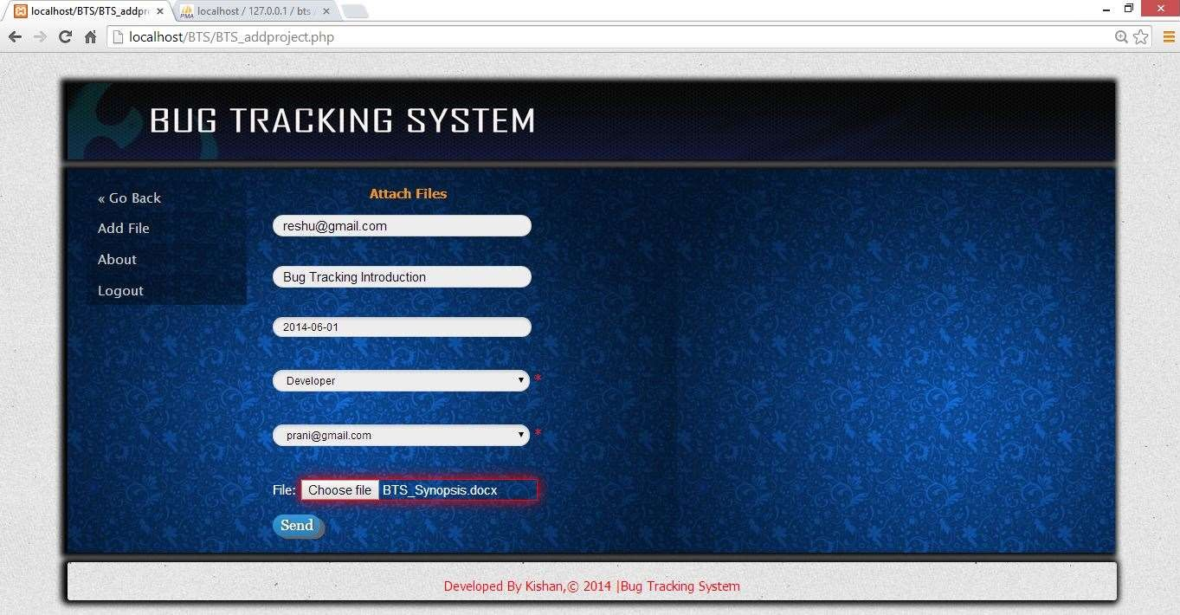
Screenshot 7: Attach File Page
This page is used to send the file to the different users using name of file, date and also receiver mail id.
25

Slide 27
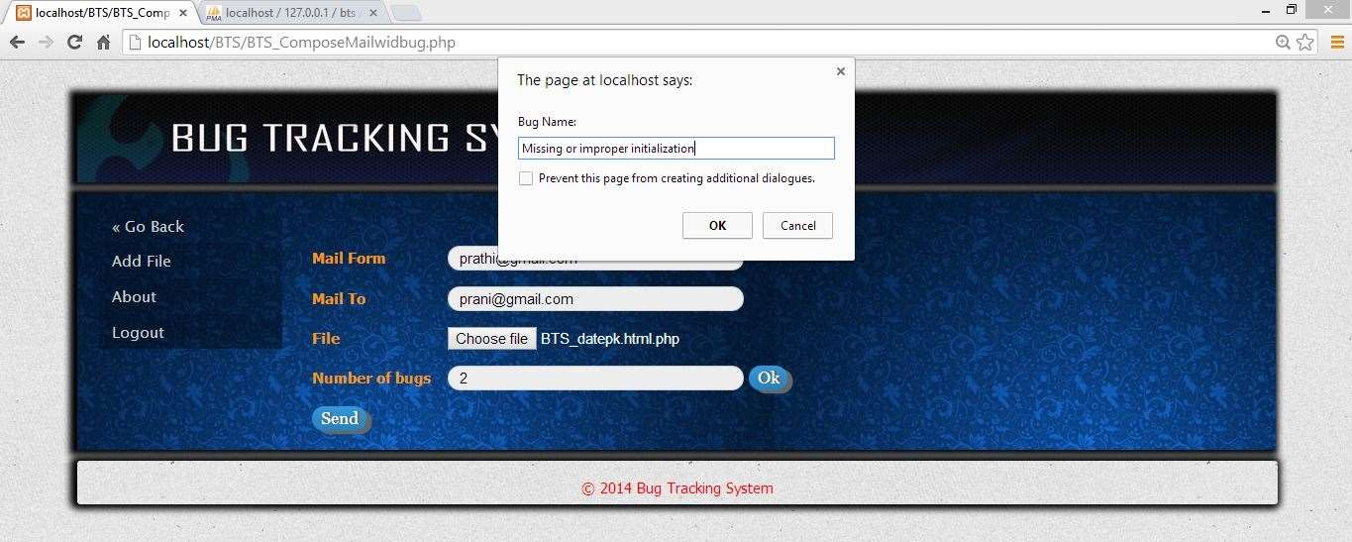
Screenshot 8: Sending Bug Form
This page is used sending the bug details to the developer and also admin using receiver mail id with attached project file.
26

Slide 28
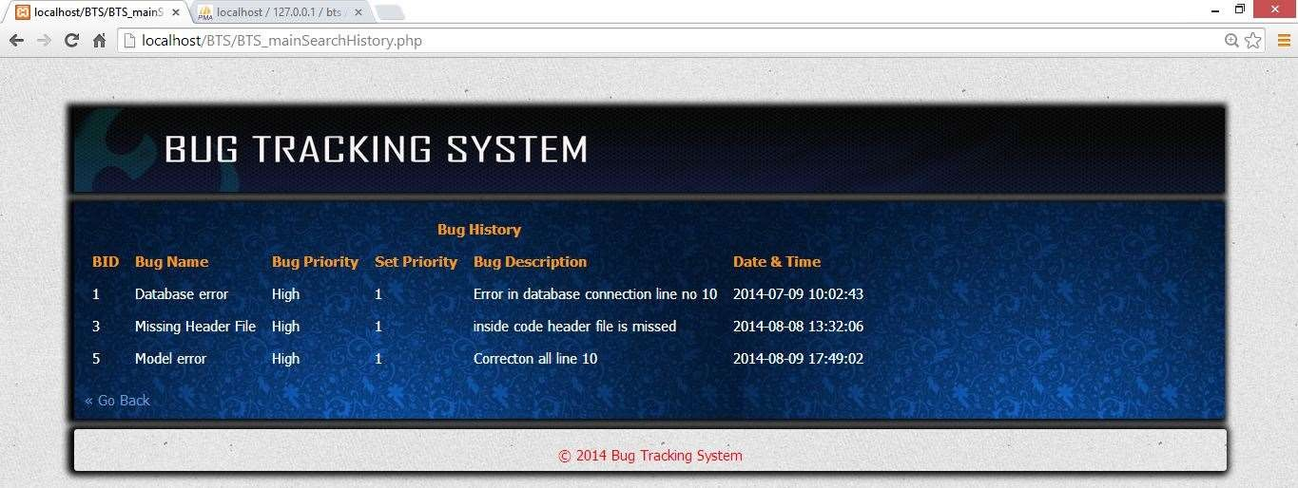
Screenshot 9: View Old Bug
In this page user can view the old bug’s information for future reference.
27

Slide 29
CONCLUSION
Bug Tracking System helps to detect and manage the bugs in software products effectively.
This project BTS can be used to track the bugs in the project modules and assist in troubleshooting errors for testing and for development processes.
This project highly avoids all sources of delay in bugs reporting level within the project modules in the software industry. As application is deployed in a company server, it is much more secure.
28

Slide 30
FUTURE ENHANCEMENTS
This Bug Tracking System can be modified and enhanced for performing more complex task related to bug tracking system.
There are many more enhancements that are pending to make this project more interactive and professional, apart from this online facility, chat room, SMS alerts to the user and a separate account will be created for the testing team to compare severity of the incoming bugs.
29

Slide 31
REFERENCES
The Complete Reference PHP 5.0 by Steven Holzner.
http://en.wikipedia.org/wiki/Comparison_of_issue_tracking_systems.
An Integrated Approach to Software Engineering, Third Edition – Pankaj Jalote
Fundamentals Of Database Systems, Third Edition – Ramez Elmasri and Shamka Navathe
Professional Web Widgets with CSS, DOM, JSON and Ajax – Rajesh Lal and Lakshmi
Chava
Beginning JavaScript and CSS Development with jQuery- Richard York
30

Slide 32



YOU

